Slide 1
Commonly Confused Words

Slide 2
Let’s start with a few you use often:
Its =
It’s =
Their =
There =
They’re =
A lot =
Alot =
Singular possessive pronoun
“it is”
Plural possessive pronoun
Location/place
“they are”
“a lot”
Not a word!

Slide 3
More common ones…
Two =
To =
Too =
Then =
Than =
Duh, the number
Direction; infinitive verb precursor
Exceedingly; also
Time reference
Comparison
Does anyone need sentence examples for any words presented on the first two slides?

Slide 4
Now for the troublesome ones…

Slide 5
Lay vs. Lie
Lay =
To place something down
Lie =
To rest or recline
Please lay the book on the table.
She wants to lie down for a nap.

Slide 6
Infer vs. Imply (You should know this one!)
Imply =
To state indirectly
Infer =
To draw a conclusion based on evidence
The act of implying is done by the person/thing providing the information (author, text, speaker, etc.), but he act of inferring is done by the listener, reader, viewer, etc.
Your look implies that I’ve disappointed you.
You might infer from this pamphlet that Mexico is a good place to visit during spring break.

Slide 7
Affect vs. Effect
Affect =
(v) To cause a change in; to have an
influence on
Effect =
(n) A result
The cold medicine affects my balance.
I don’t like the effects of this cold medicine.

Slide 8
Farther vs. Further
Farther =
Use when referring to physical, measurable distance
Further =
Use when referring to additional time or amount; use with metaphorical distance
We drove farther down the road.
There will be no further discussion about this!

Slide 9
Fewer vs. Less
Fewer =
Use when referring to something that is able to be counted
Less =
Use when referring to something that is NOT able to be counted
I have less time to do homework tonight.
When time changes in the autumn, it feels like there are fewer hours in the day!

Slide 10
Fewer vs. Less, cont.
Remember two things…
(1) You have to take this literally, not conceptually.
(You do not count money, but you do count dollars!)
I have less money now that I bought the car, but it cost me fewer dollars than my last one.
(2) Just because you can count it doesn’t mean you’d want to.
(You’d never want to count concert goers, but you could if you had enough time, so there are fewer concert goers this year compared to last year).

Slide 11
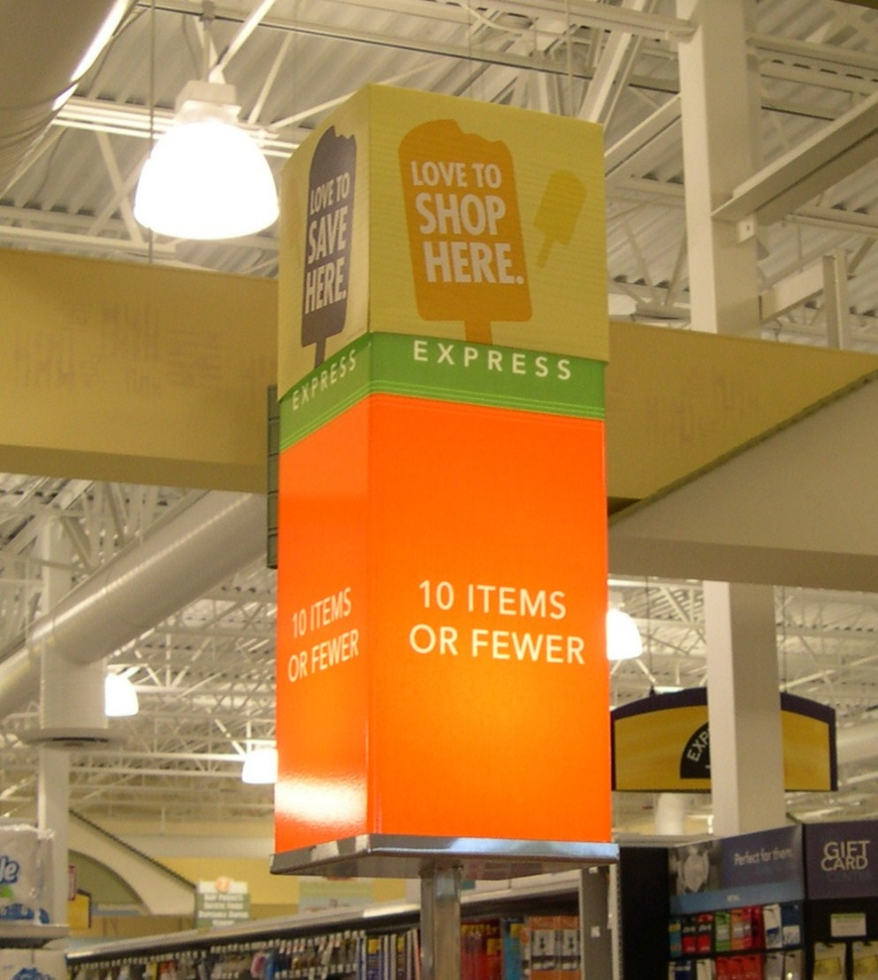
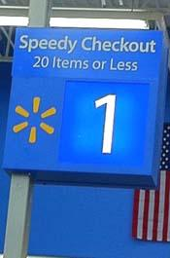
Real Life
Really, Walmart? Busted!
Publix (Grocery Store) wins the intelligence award!

Slide 12
Who vs. That (when referring to people and things ONLY)
Who =
Use when referring to people
That =
Use when referring to objects
My uncle, who owns a boat, lives in Florida.
The desk that has a broken leg is dangerous!
What about dogs? What about characters in a book?

Slide 13
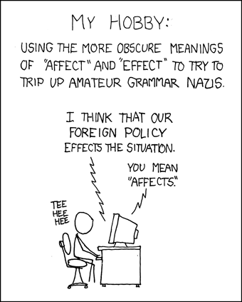
The end. ☺

