Slide 1
Who’s Who in Mythology?

Slide 2
Greek Gods and Goddesses

Slide 3
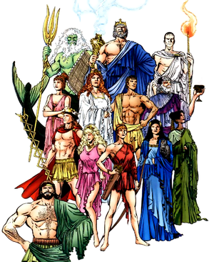
The 12 Olympians
Gods of Olympus who ruled after the overthrow of the Titans.
Rule from Mount Olympus
Factor into most of Greek and Roman mythology

Slide 4
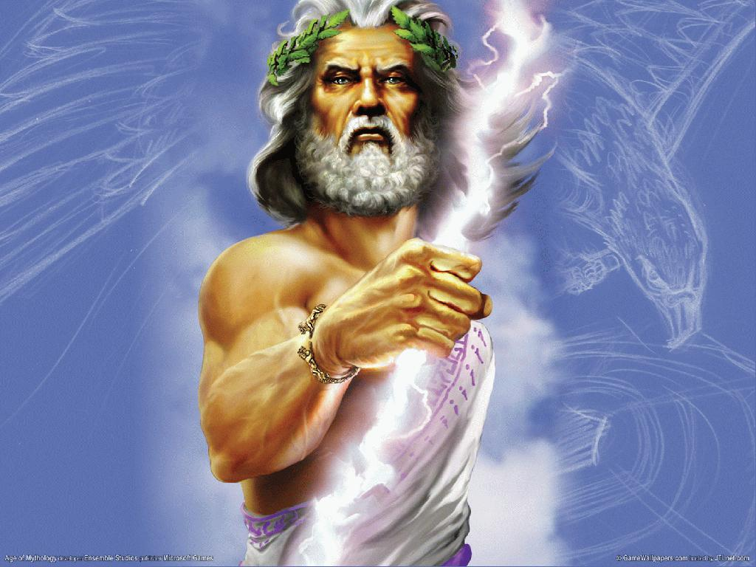
Zeus (Jupiter)
King of the gods
Ruler of the sky and weather
Upholder of oaths and hospitality

Slide 5
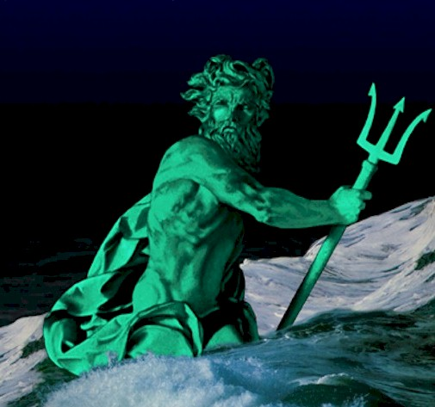
Poseidon (Neptune)
Brother of Zeus
Ruler of the sea, horses, and earthquakes
Plays a crucial role in Odyssey

Slide 6
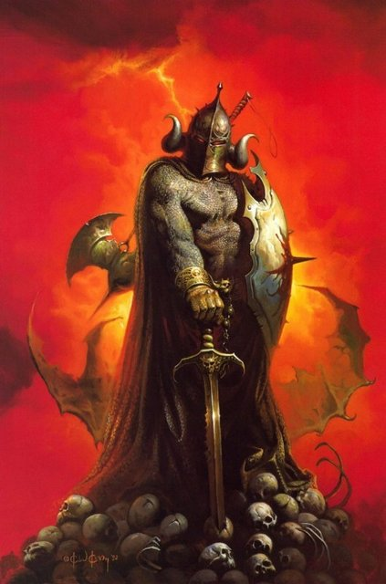
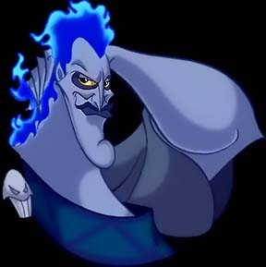
Hades (Pluto)
Brother of Zeus
Ruler of the Underworld

Slide 7
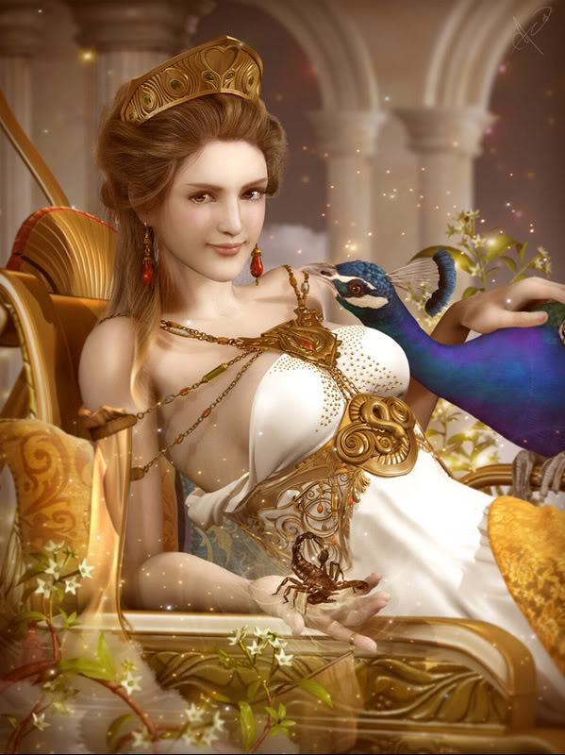
Hera (Juno)
Sister of Zeus
Wife of Zeus
Queen of the gods
Upholder of marriage

Slide 8
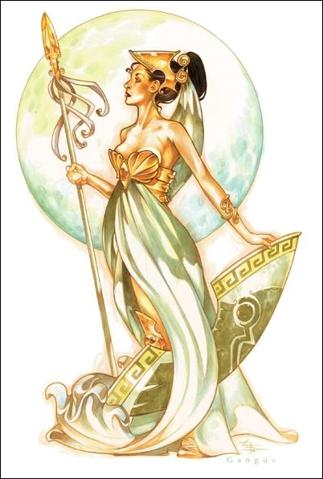
Athena (Minerva)
Daughter of Zeus
Goddess of wisdom, warfare, and craft
Major character in Odyssey

Slide 9
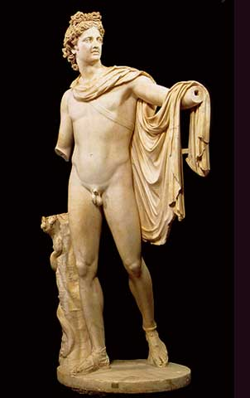
Apollo (Apollo)
Son of Zeus
God of the Sun
God of music, prophecy, and the arts
Youth
Archery
Healing and plague

Slide 10
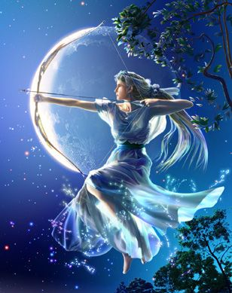
Artemis (Diana)
Daughter of Zeus; twin sister of Apollo
Goddess of hunting, wild animals, and childbirth
Known as the Virgin Goddess
The moon

Slide 11
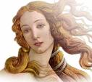
Aphrodite (Venus)
Born from sea foam
Iliad considers her to be a daughter of Dione
Married to Hephaestus
Goddess of love, beauty, and pleasure

Slide 12
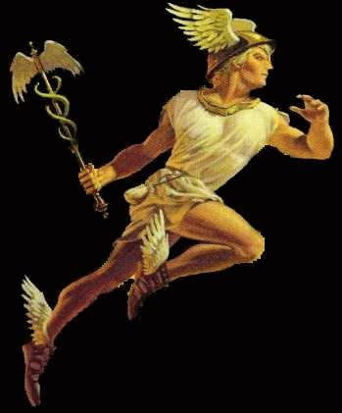
Hermes (Mercury)
Son of Zeus
Messenger of the gods
God of travelers, commerce, and trickery, thieves, science
Provides aid to Odysseus

Slide 13
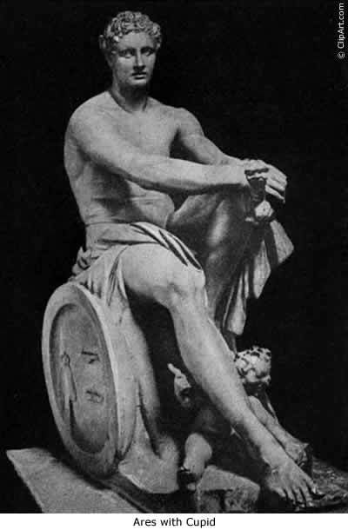
Ares (Mars)
Son of Zeus and Hera
God of war
While Athena was seen as strategic in war, Ares was seen as unpredictable and violent.

Slide 14
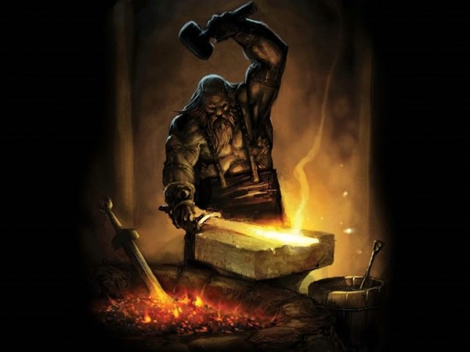
Hephaestus (Vulcan)
Son of Hera (and Zeus?)
Fire
Smelting
Crafts
Blacksmith for the gods

Slide 15
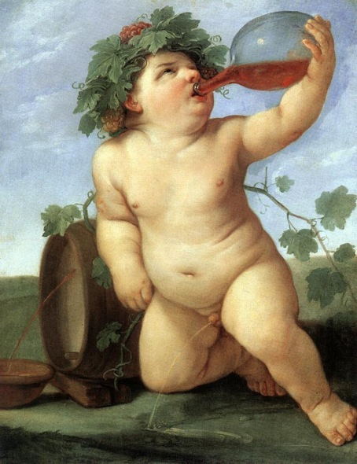
Dionysus (Bacchus)
Said to be born of Zeus’ thigh
God of Liberation and Wine
Associated with:
Music
Theater
Fertility

Slide 16
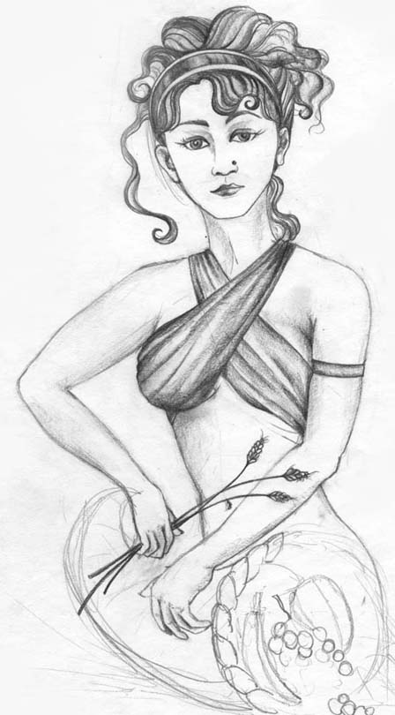
Demeter (Ceres)
Sister of Zeus
Goddess of the earth, corn, and crops

Slide 17
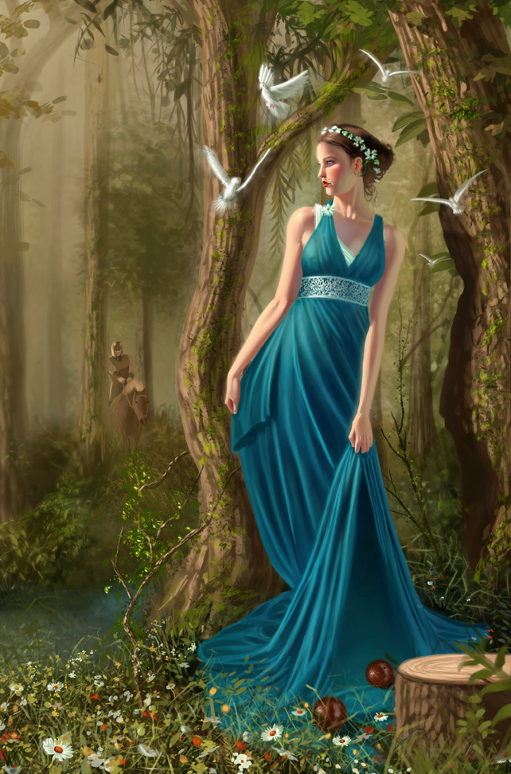
Persephone (Proserpina)
Daughter of Demeter & Zeus
Wife of Hades
Queen of the Underworld
Spends six months in the underworld (winter) and six months with her mother (summer)

Slide 18
Important Themes in Mythology

Slide 19
Myth “Ethics”
Good was rewarded, evil was punished
You do NOT want to anger a god, or bad things will happen to you.
When you did anger a god, you performed a sacrifice to atone for the mistake.
Sometimes this included giving the god something
Sometimes it involved a journey
Odysseus angers Poseidon and is forced to undergo many trials before getting home

Slide 20
Fate
Fate was a powerful force that neither gods nor mortals could contend with
Your path in life was determined by the gods (Three Fates), and often unalterable
Fate was taken very seriously in Greek world
Countless myths feature characters trying to fight fate, or change the course of their life/destiny.

Slide 21
Vengeance
“Blood begets blood.”
Loyalty bonds: you avenge the death of another family member
Life for a life
In the Odyssey, when the Cyclops kills Odysseus’ men, Odysseus must avenge them by killing the Cyclops.

Slide 22
Hospitality/Generosity
Both very important and noble qualities in the Greek world
You always opened your home to strangers—you never knew if it a was a god come down to earth
We’ll see that Telemachus, Odysseus’ son, opens his home to over 20 suitors who seek to marry Penelope
Strangers also provide Odysseus with shelter, food, and supplies before they even know his name
This generosity is a form of sacrifice and love that puts people on the gods’ good sides.
Many myths show those who refuse hospitality coming to terrible ends.

Slide 23
Homer’s The Odyssey

Slide 24
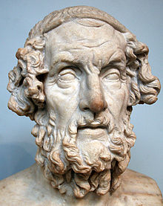
Homer
A blind poet, probably born in Ionia between 850 and 600 B.C.
Cited as the greatest ancient Greek poet
Credited with composing both The Iliad and The Odyssey
These works are the longest surviving mythic manuscripts, and also the most famous of classical mythology
They are also considered the first major works of Western civilization

Slide 25
Iliad and Odyssey
Believed to have been composed between 750 and 650 B.C.
Set nearly 500 years earlier, during the Bronze Age of Greece (12th century BCE)
Speaks about the heroes of the Trojan War (Iliad) and the journey home from the war (Odyssey).

Slide 26
Epic Poetry
Epics are long, narrative poems that recounts the actions, adventures, and travels of an epic hero.
Handed down through the oral poets
Heroes embody the values of their civilization.
Primary purpose:
To entertain
to teach
to inspire

Slide 27
Epic Conventions
The work begins “in medias res” (“in the middle of things”)
Odysseus’s story begins in the middle of his journey
The poem will often open with an invocation of the muse asking for assistance in telling the story.
“Sing to me of the man, Muse, the man of twists and turns”

Slide 28
Main character is a physically impressive hero of national or historical importance.
Odysseus fought for ten years in the Trojan War and devised the idea of the Trojan Horse.
Setting is vast in scope, including much of the physical world and, at times, the land of the dead.
Odysseus’ travels take him throughout the Mediterranean World.
The action consists of deeds of great valor or requiring superhuman courage.
In The Odyssey, Odysseus must overcome many challenges.

Slide 29
There is evidence of supernatural forces at work.
In the Odyssey, the hero encounters gods, goddesses, sorceresses, monsters, giants, etc.
Formal, elevated language
Epics will be rooted in a specific culture and society.
The Odyssey, for example, is heavily rooted in Greek society and culture.

Slide 30
Terms to Know
Epithet—a descriptive phrase applied to a person or thing that emphasizes a particular quality or attribute; often repeated throughout the text
“the man of twists and turns”; “gray-eyed Athena”; “Dawn with fingertips of rose”
Epic Simile—a long, elaborate simile that goes on for a number of lines; often compares heroic or epic events to understandable and everyday things

Slide 31
Hubris—excessive pride
Offends the gods; many stories tell of people being punished for the sin of hubris
Look for how this affects the characters in our story!
Xenia—Greek cultural custom of hospitality
Generosity and courtesy to those far from home
Kleos—renown or glory
A hero can achieve kleos by accomplishing great deeds, often with his own death

Slide 32
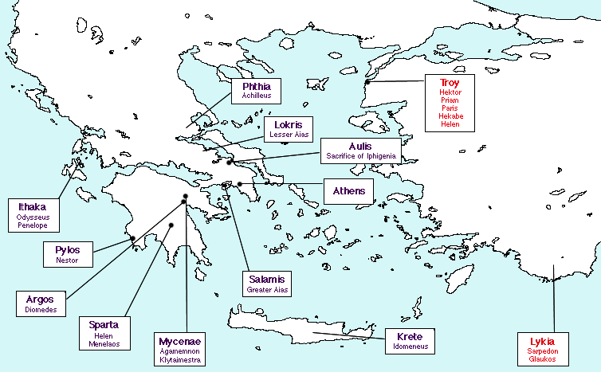
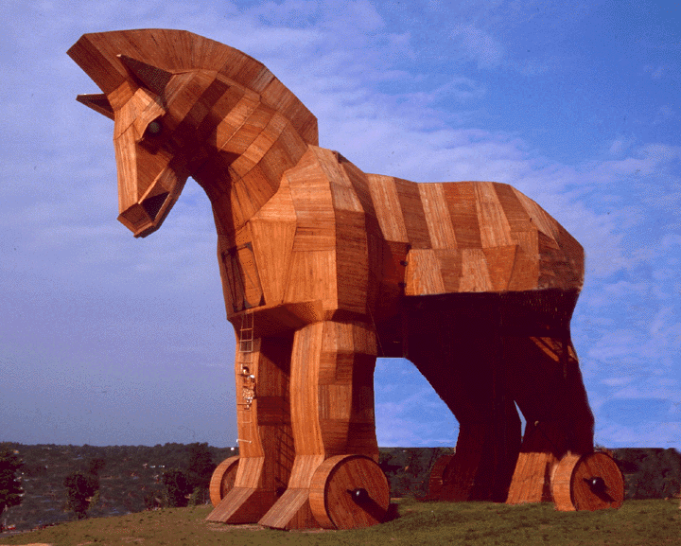
The Trojan War (Iliad)
Began when Helen, the most beautiful woman in the world, ran away with Paris, Prince of Troy
Her husband, Menelaus, rounds up the Greeks and goes to “win” her back.
War is a stalemate for 10 years
Trojan Horse: Greeks hid in the horse, which was brought into the city
Greeks captured the city and won the war

Slide 33
Greeks all went home after the war
Odysseus, however, takes 10 years to get home to Ithaca.
Many people believe he is dead
It has been 20 years since Penelope, his wife, has seen her husband.
She is being pursued by countless men, but is loyal to her husband
His son Telemachus is all grown up and impatient for his father’s return
All Odysseus wants to do is get home
The Odyssey is the story of Odysseus’ journey home.

Slide 34
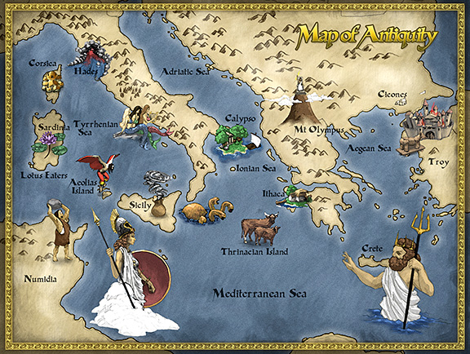
Map of Journey

Slide 35
Characters
Odysseus/Ulysses: Epic Hero, King of Ithaca
Known for his courage, cunning, and intelligence
Simply wants to get home!
Athena, goddess
Often disguised as Mentor
Provides divine assistance for both Odysseus and Telemachus
Penelope, Queen of Ithaca
Odysseus’ wife; she pines away for his return
Is crafty and intelligent
Laertes
Odysseus’s father

Slide 36
Telemachus, Prince of Ithaca
Odysseus’ son who becomes a “man” throughout the epic, keeping the suitors at peace while helping his father return
Tiresias
Prophet with divine wisdom who tells heroes of their fate, or destiny
Warns against certain actions
Many people fail to listen to him, and find disaster
Zeus
He mediates the disputes between gods, and either aids (or doesn’t) Athena’s plan with Odysseus

Slide 37
Alcinous, King of the Phaecians
Gives a banquet in Odysseus’s honor in which Odysseus tells of his adventures to this point.
Sirens
Sea nymphs who sing songs that lure men to their deaths
Charybdis
Dangerous whirlpool personified as a female monster
Scylla
Six-headed female sea monster

Slide 38
Circe
A witch Odysseus must charm; becomes her lover for a year
Calypso
Falls in love with Odysseus; holds him captive for 7 years
Polyphemus (aka Cyclops)
A one-eyed monster Odysseus must defeat
Poseidon
Is angered by Odysseus’ treatment of Polyphemus, delays Odysseus’ journey

Slide 39
Eurylochus
One of Odysseus’ men who sometimes disagrees with Odysseus
Eumaeus
The loyal swineherd who shelters Odysseus when he returns
Eurycleia
Odysseus’ childhood nurse, and loyal to him
Antinous
Lead suitor; he is arrogant and disrespectful
There are many other significant characters not listed here!

Slide 40
Structure of The Odyssey
24 Books (similar to chapters)
We will be reading Books 9-12 (his adventures) and excerpts from Books 21-24 (his homecoming).
The books we are skipping detail what is happening in Ithaca and with his son Telemachus in Odysseus’ absence.
Non-linear.
Books 9-12: Odysseus is telling what happened to him and his men from the end of the Trojan War at a banquet given in his honor by King Alcinous.
This is right before he makes it back to Ithaca.

